Slide 1
Music band website

Slide 2
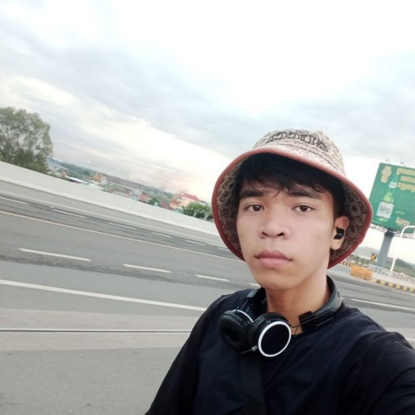
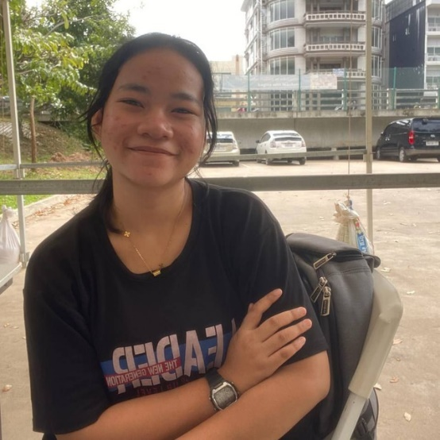
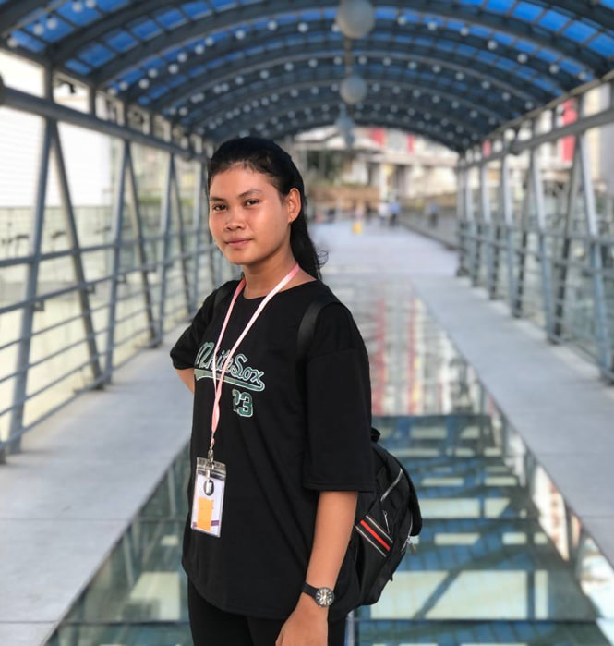
Our team
Sopanha SIn
Radit Thy
Ma Ny

Slide 3
Our agenda
-Demo application
-Sell application
- The Challenge
- What have we learnt from this project
- Conclusion

Slide 4
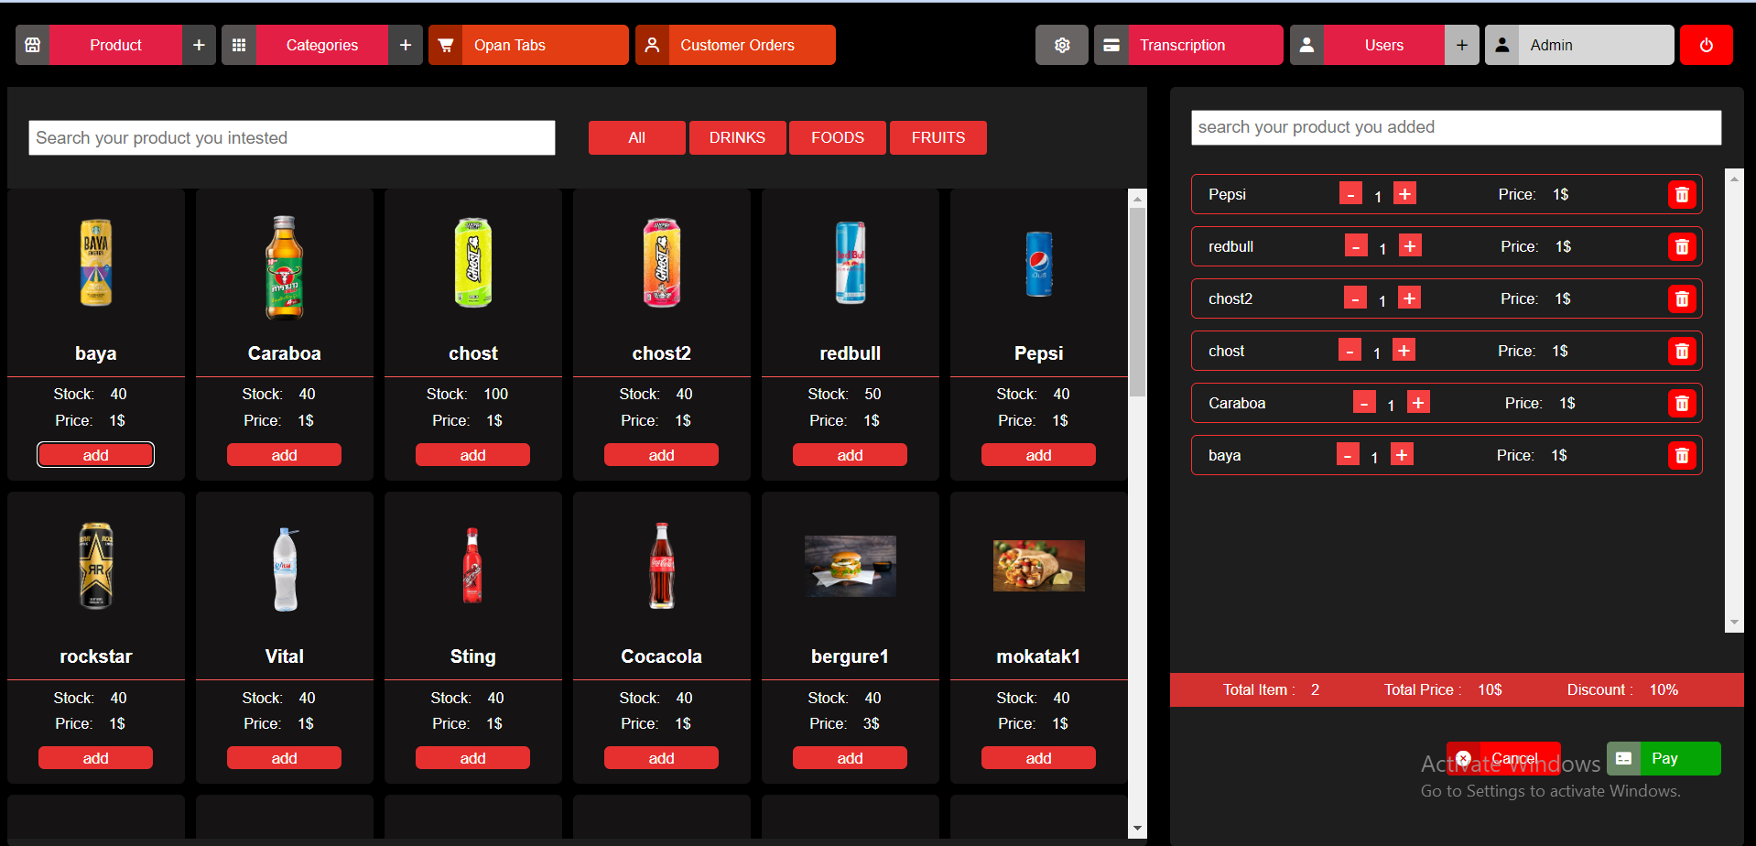
Demo application
What is the name of website?
What is the type website?
Why we create it ?

Slide 5
Name Ma Ny
Task Manager
CODER

Slide 6
Detail with the real project
Category
User
History
Product

Slide 7

Name Veoun Chanthou
QA Tester
CODER

Slide 8
Sell application

Slide 9
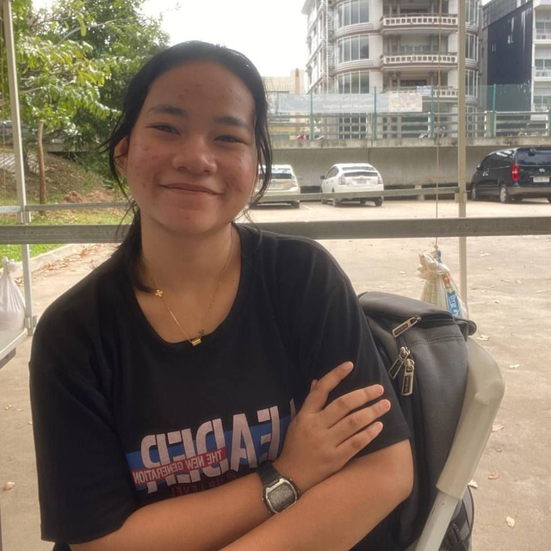
Name Mao Vanny
Git Manager
CODER

Slide 10
Challenge
- Misunderstanding
- Use github
- Difficult to divide task
- Conflict file
- Poor UI/UX
- Fix bugs
- Error code
- None comment code
- Find information about band
- Time managment

Slide 11
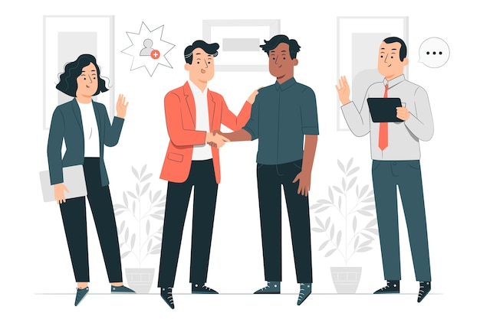
What have we leant form our project?
Hard skill
soft skill

Slide 12
Hard skill
- Design mockup
- Find the bug
- Use github
- Use new animation
- Write SCSS
- Hosting web site on vercel

Slide 13
soft skill
- Communicate
- Solidarity
- English skill
- Flexibility
- Time managment
- Searching

Slide 14
Conclusion

